Slide 1
Tutorial
Wc 11.11.24

Slide 2



Slide 3
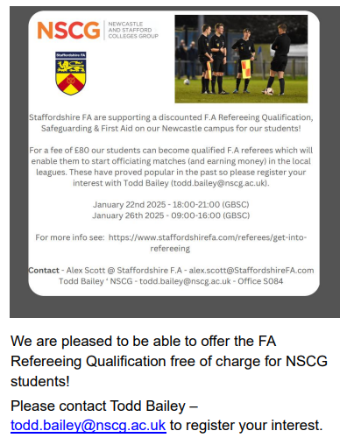


Slide 4
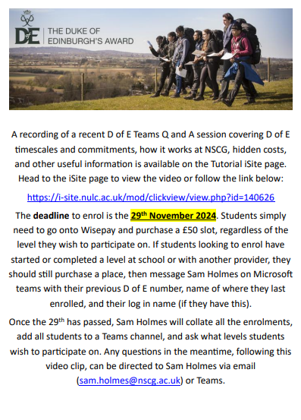
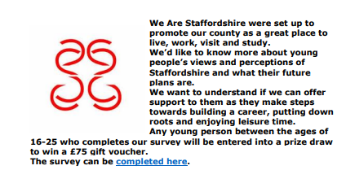
https://r1.dotdigital-pages.com/p/71SI-G3D/share-your-views
https://i-site.nulc.ac.uk/mod/clickview/view.php?id=140626

Slide 5

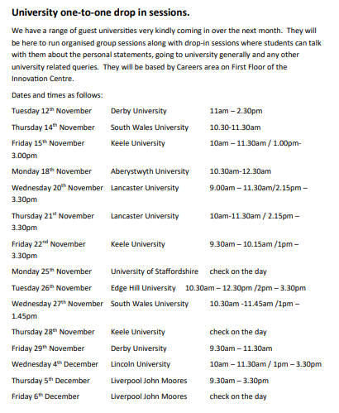

Slide 6
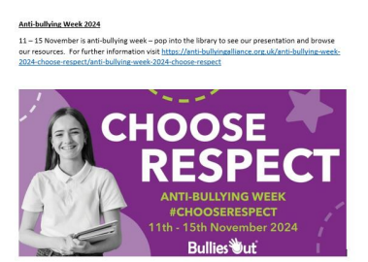

Slide 7



Slide 8
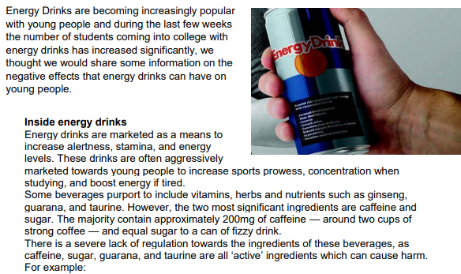
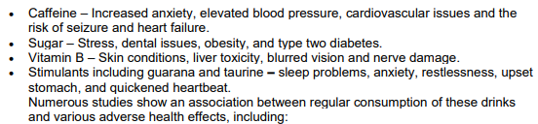


Slide 9
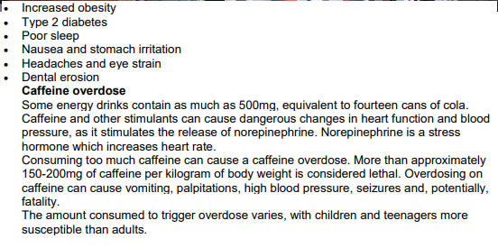
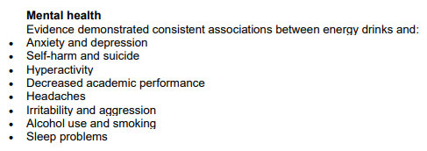
Create a poster advertising the disadvantages of energy drinks.

Slide 10
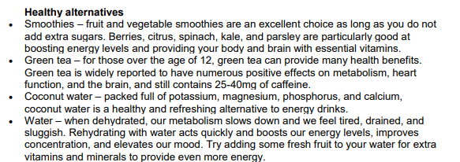

https://www.smartsurvey.co.uk/s/interactive-career-pathways-students-survey-Oct24/

